Slide 1
Chapter 16
Event-Driven
Programming

Slide 2
At the end of this lecture ..
Understand the concept of event-driven programming
  Understand the relationship between these three objects: a component, an event object, and a listener object
Handle an event fired by a click of a button
Handle an event fired by a mouse drag
Realize that the same principle could be used to handle other events fired from other components

Slide 3
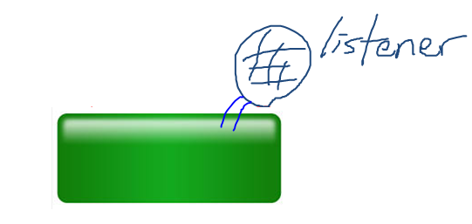
Making a component respond
It is all about building a listener object (rewrite some abstract methods) and attaching it to a component such as a button:

Slide 4
Event-Driven Programming:
2 Steps
Define a listener class
  Implement (inherit) an interface
  Override abstract method(s) in the interface
Create an object of your listener class and register (“attach”) it with the source object (e.g. button)

Slide 5
Delegation
  Any event fired by the source object is delegated to the attached listener object to process the event

Slide 6
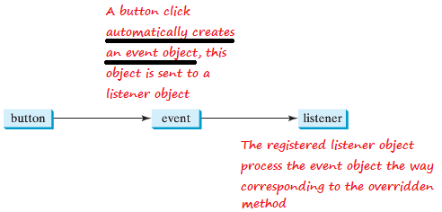
To handle an event: button click
The button must be registered with a listener object

Slide 7

Example: Step 1
Interface:
ActionListener
Overriding abstract method: actionPerformed(ActionEvent e)

Slide 8
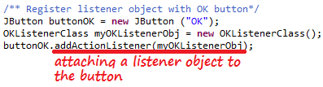
Example: Step 2
Create an object of your listener class and register (“attach”) it with a button:

Slide 9
Events
External user actions
  Action events (pressing enter key in text field, checking or unchecking a radio button, etc.)
  Mouse events (e.g. mouse clicks, mouse moving in or out, etc.)
  Key events (i.e. key pressed/released/typed)
Internal event
  timer

Slide 10
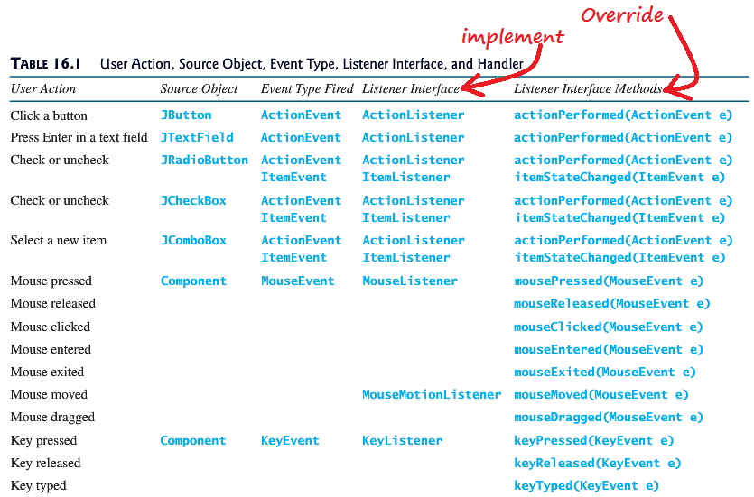
User Action Events
A component of a subclass can fire the same events of its superclass

Slide 11
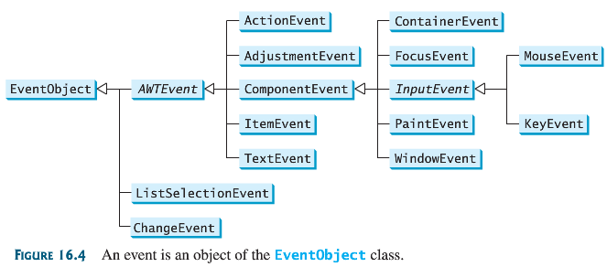
Events (cont.)
An event could be an object of any of these event classes (java.util.EventObject)

Slide 12
Questions
Can a button fire a MouseEvent?
Can a button fire a KeyEvent?
Can a button fire an ActionEvent?

Slide 13
Answers
Can a button fire a MouseEvent?
  Yes, since all awt and Swing components are descendants of Component which supports mouse events
Can a button fire a KeyEvent?
  Yes, since all awt and Swing components are descendants of Component which supports key events
Can a button fire an ActionEvent?
  Yes, ActionEvents are meant to be fired by Timer objects and buttons

Slide 14
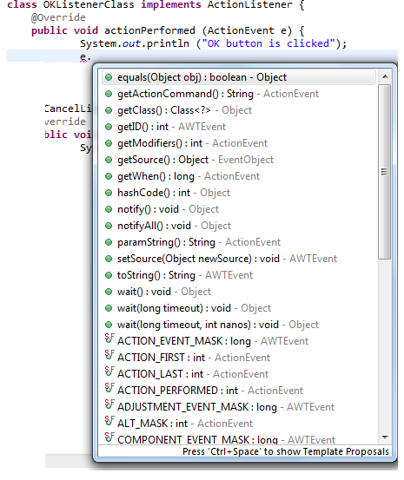
Events (cont.)
A peek at properties of an ActionEvent object

Slide 15
Some information from an event object
getSource() … returns object source
getActionCommand()… returns command name (“null” returns the label on the button)
getModifiers()… returns modifier key (alt, ctrl, meta, etc) held down
getWhen()… returns when event occurs, milliseconds since UNIX epoch

Slide 16

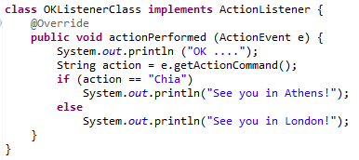

Set and get “action commands”

Slide 17
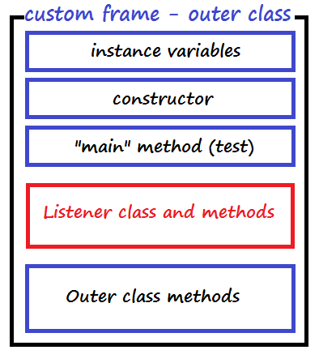
Advice: Make Listener classes as inner class
The advantage of inner class is that it has direct access to properties of the outer class

Slide 18
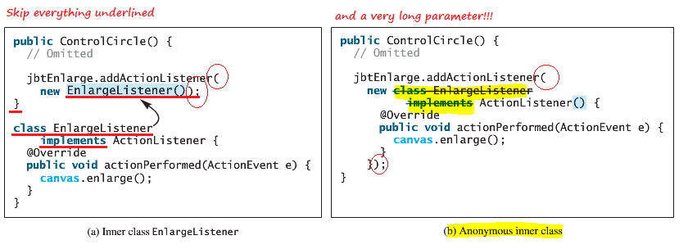
Alternative 1: Use anonymous inner class; good if only one source object uses it

Slide 19
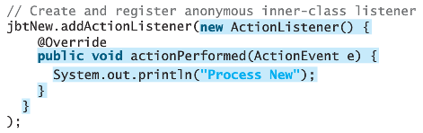
Another example: Anonymous Interface

Slide 20
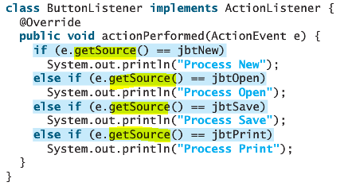
Alternative 2: Good for a listener to be used for multiple sources
Defining one listener class for handling a large number of events is efficient.
The getSource method helps to decide which component has fired the event:

Slide 21
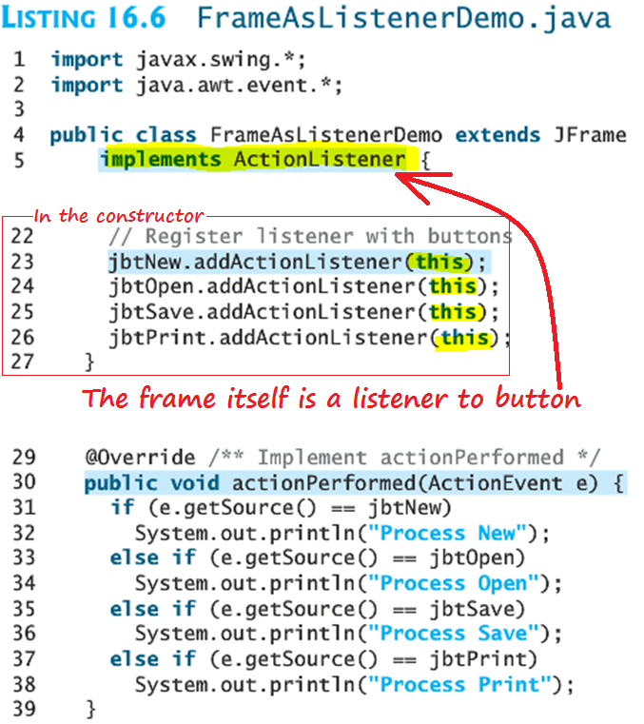
Alternative 3 (not a common practice): Your outermost custom frame implements a listener interface

Slide 22
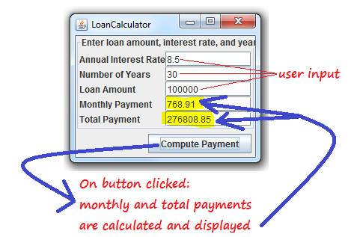
Loan Calculator

Slide 23
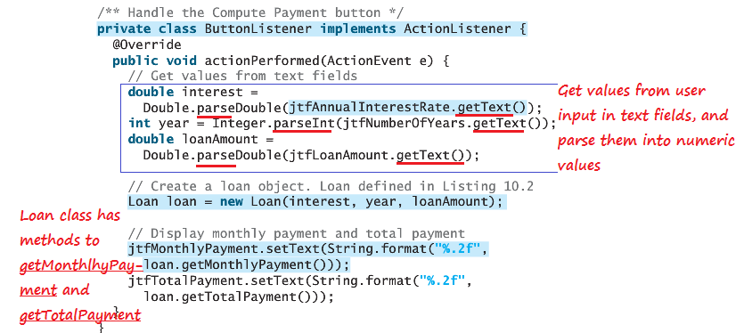
When the button “Compute Payment” is clicked, actionPerformed is invoked
To compute total payment based on a loan and a loan period, Listing 16.7 overrides actionPerformed:

Slide 24
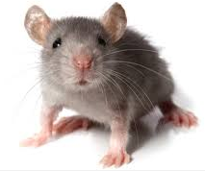
Mouse Events

Slide 25
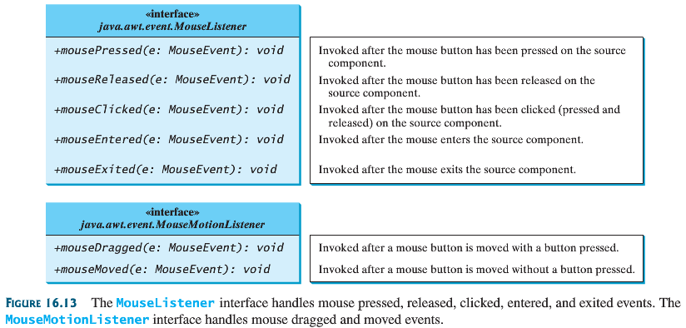
Implement: Two interfaces
MouseListener
MouseMotionListener

Slide 26
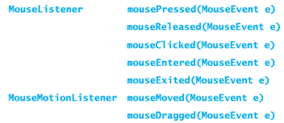
Override these abstract methods

Slide 27
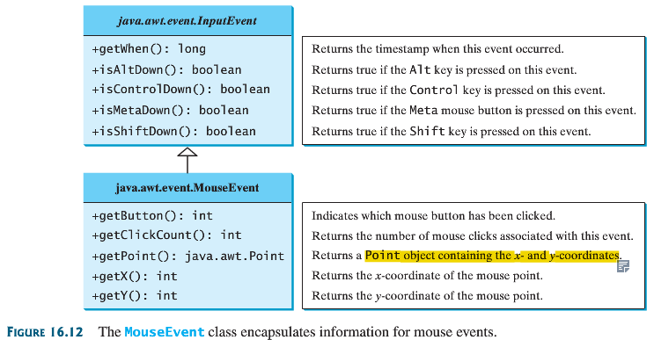
Useful methods from MouseEvent class

Slide 28
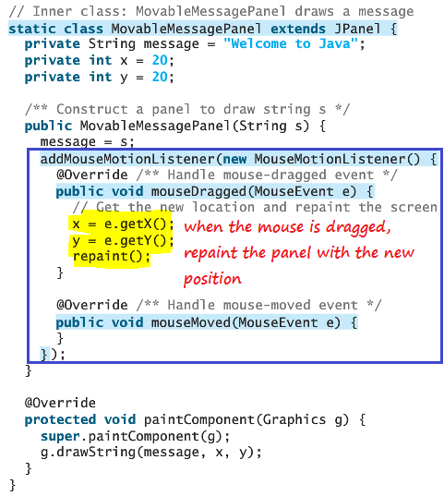
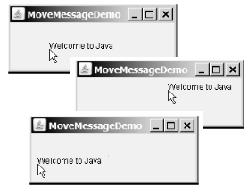
Example of mouse drag event
Invoking the
repaint() method causes paintComponent to be invoked, which displays the message in a new location.

Slide 29
30 Lab credits
Exercise 1 AND 2, OR
Exercise 3

Slide 30
Exercise 1
Create a button called Pig that responds to different action commands
  (Console) Display “play in mud” when action command “play” is set as action command for the button
  (Console) Display “eat like a pig” when action command “eat” is set as the action command for the button

Slide 31
Exercise 2
Copy/paste into Eclipse and test it (more code on next slide)
import javax.swing.*;
import java.awt.*;
import java.awt.event.*;
public class ControlCircle extends JFrame {
private JButton jbtEnlarge = new JButton("Enlarge");
private JButton jbtShrink = new JButton("Shrink");
private CirclePanel canvas = new CirclePanel();
public ControlCircle() {
JPanel panel = new JPanel(); // Use the panel to group buttons
panel.add(jbtEnlarge);
panel.add(jbtShrink);
this.add(canvas, BorderLayout.CENTER); // Add canvas to center
this.add(panel, BorderLayout.SOUTH); // Add buttons to the frame
jbtEnlarge.addActionListener(new EnlargeListener());
}
/** Main method */
public static void main(String[] args) {
JFrame frame = new ControlCircle();
frame.setTitle("ControlCircle");
frame.setLocationRelativeTo(null); // Center the frame
frame.setDefaultCloseOperation(JFrame.EXIT_ON_CLOSE);
frame.setSize(200, 200);
frame.setVisible(true);
}
class EnlargeListener implements ActionListener {
// Inner class
@Override
public void actionPerformed(ActionEvent e) {
canvas.enlarge();
}
}

Slide 32
Exercise 2 (Cont.)
Implement “shrink” circles
class CirclePanel extends JPanel {// Inner class
private int radius = 5; // Default circle radius
/** Enlarge the circle */
public void enlarge() {
radius++;
repaint();
}
@Override
protected void paintComponent(Graphics g) {
super.paintComponent(g);
g.drawOval(getWidth() / 2 - radius, getHeight() / 2 - radius,
2 * radius, 2 * radius);
}
}
}

Slide 33
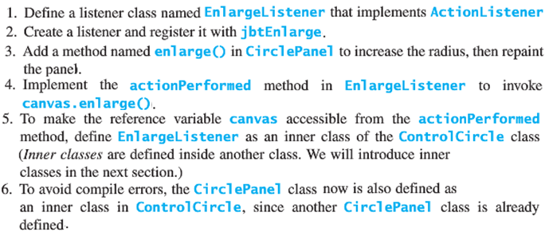
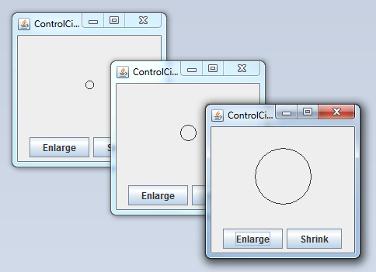
Exercise 2 (cont.)
Use the implementations of “enlarge” button as a guide, complete the implementations of the “Shrink” button.
Note how a method is called to repaint the canvas

Slide 34
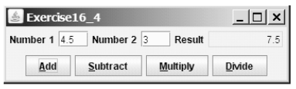
Exercise 3
Reference: slide 23

